Slide 1
Mapping Genomic Sequences Using Optical Reference Tags
ACGT team meeting
17th Oct, 2012
Yaron Orenstein and Omer Zuqert

Slide 2
Talk overview
Introduction: technology.
Mathematical formalization of the problem.
Solution: dynamic programming.
Results.
Summary.

Slide 3
INTRODUCTION

Slide 4
Presentation based on two papers
Genomics via Optical Mapping IV: Sequence Validation via Optical Map Matching
Marco Antoniotti, Thomas Anantharaman, Salvatore Paxia, Bud Mishra
NYU, Technical report, 2001
Genome Mapping on Nanochannel Arrays for Structural Variation Analysis and Sequence Assembly
Ernest T Lam, Alex Hastie, Chin Lin, Dean Ehrlich, Somes K Das, Michael D Austin, Paru Deshpande, Han Cao, Niranjan Nagarajan, Ming Xiao & Pui-Yan Kwok
University of California, Nature Biotechnology, 2012

Slide 5
Optical genome mapping
DNA sequences are cut to fragments using restriction enzymes.
These fragments are attached to a glass (in an electric field), and their length is measured.
Using the lengths and the known restriction site, mapping to the genome is possible.

Slide 6
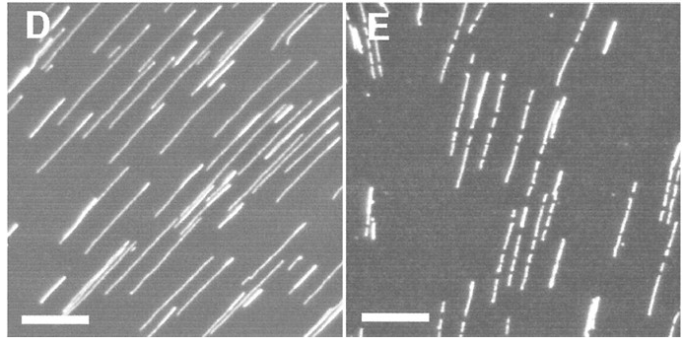
Microscopic image
Before and after enzyme digestion.
(Jing et al., PNAS 98)

Slide 7
Noise in optical mapping
DNA sequences are not completely stretched.
Enzymes can miss a restriction site, or cut in a new site.
Orientation is unknown.
Thus, requires aggregation for reliable results.

Slide 8
New optical mapping
DNA molecules run through a microfluidic channel (thus, less wiggle).
Use multiple florescent enzymes to tag sites.
Color to measure AT-content in 1000bp windows.

Slide 9
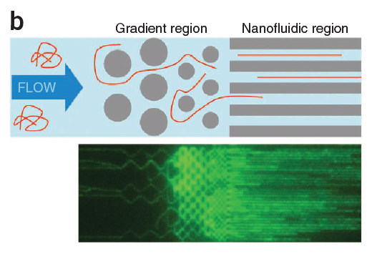
Nonachannels illustrations
A gradient region is in front of the nanochannels. The molecules are forced to flow by the pillars (Lam et al., NBT 2012).

Slide 10
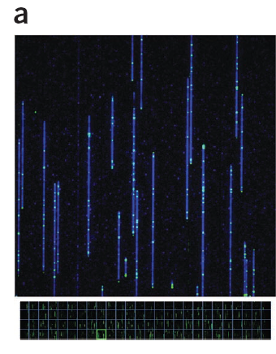
Microscopic image
A mixture of nick-labeled DNA molecules in the nanoarray (73×73μm). Up to 1Mb of a DNA molecule from top to bottom.
(Lam et al., NBT 2012)

Slide 11
Applications
Filling the gaps of next-generation sequencing:
Constructing repetitive segments.
Finding sequence errors / single site variability.
Measuring structural variation (without sequencing).
Locating epigenetic marks (DNA methylation and nucleosomes positioning).

Slide 12
Example of Lam et al., NBT 2012
MHC are cell surface molecules that mediate interactions of white blood cells.
MHC genomic region us 4.7MB long.
Examples shown on 49 and 46 BAC clones from two individuals (PGF and COX, respectively).

Slide 13
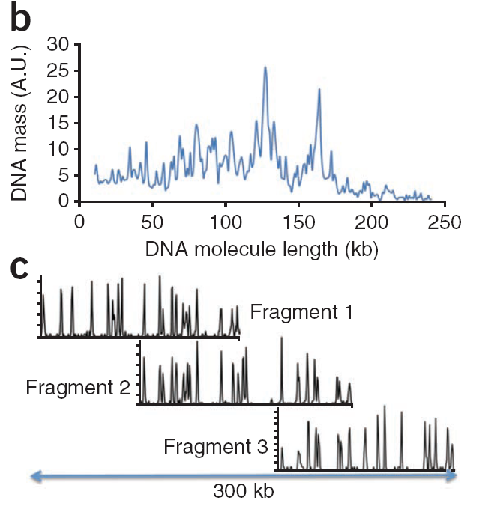
Lengths and maps
(b) The distribution of the DNA molecules imaged on the nanoarray by length.
(c) Three overlapping consensus maps (each ~150 kb long) are assembled into a 300-kb map.

Slide 14
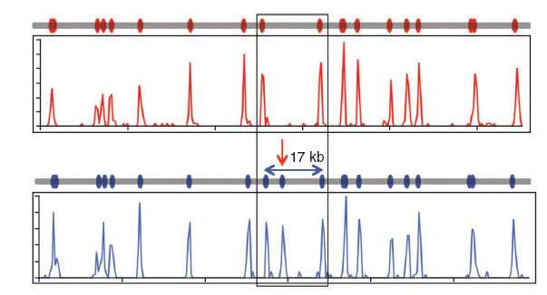
Single site variation
PGF genome (blue line) contains an extra Nt.BspQI site not found in the COX genome (red line) with the maps generated by genome mapping showing the expected pattern.
(Lam et al., NBT 2012)

Slide 15
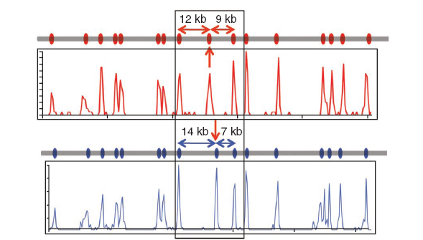
Shifting of a site
The 21-kb region is split into 12- and 9-kb fragments in the COX genome (red line) but 14- and 7-kb fragments in the PGF genome (blue line).
(Lam et al., NBT 2012)

Slide 16
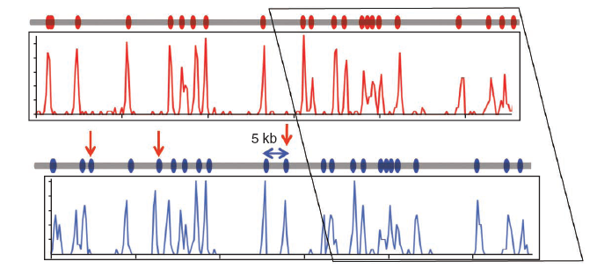
Insertions identification
The PGF genome has a 5-kb insertion that also includes an Nt.BspQI site (blue line) when compared to the COX genome (red line).
(Lam et al.,
NBT 2012)

Slide 17
Duplication
A 30-kb duplication at the RCCX locus is identified and localized in both the reference map (gray line) and that produced by genome mapping (blue histogram plot).
(Lam et al., NBT 2012)

Slide 18
Yuval Ebenstein’s lab
Goal: use minimum number of fluorescence tags to accurately map genomic sequences.
Aim: measure disease-causing structural variability in the telomere part of the genome.
Additional (free) information: AT-content averages in 1000bp resolution.

Slide 19
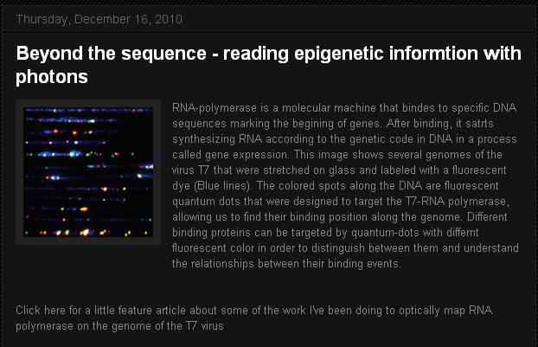
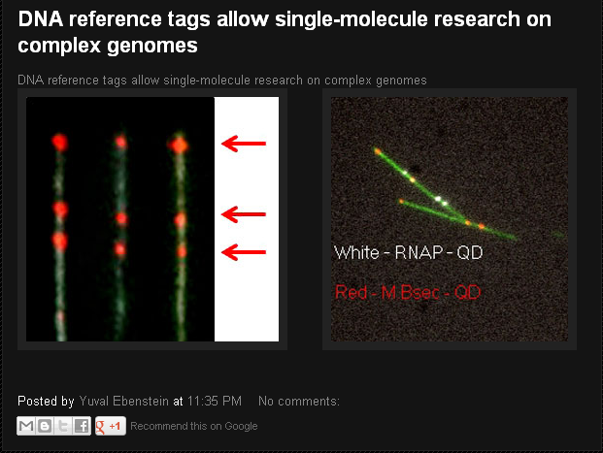
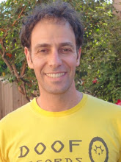
Ebenstein’s lab webpage

Slide 20
MATHEMATICAL FORMALIZATION

Slide 21
Problem definition
Input: a vector of lengths, representing length in base pairs between fluorescence tags.
Output: chromosome number of the DNA molecule.
Parameters: false positive and false negative rates of fluorescence tags, standard deviation of the stretch factor.

Slide 22
Consensus and sequence maps
A consensus optical map is an ordered restriction map, represented as a vector of fragments: <c_{i}, l_{i}, σ_{i}>.
c_{i} = cut probability, l_{i} = mean length, σ_{i} = std of length variable (strech factor).
A sequence map is an in silico ordered map.

Slide 23
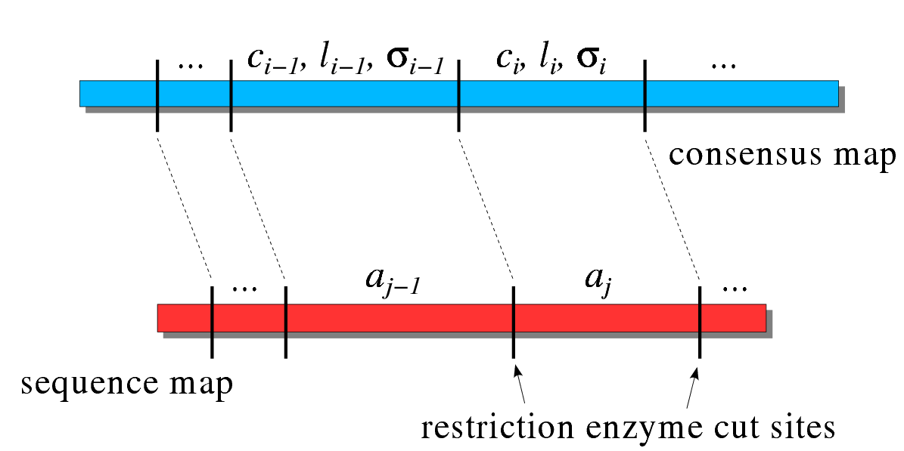
A simple matching
(Antoniotti et al., Technical report, 01)

Slide 24
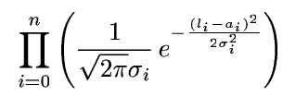
Objective function
The probability for a consensus map is:
Taking the logarithm:
Minimizing “weighted sum-of-squares”:

Slide 25
False cuts and missing cuts
Probability for a no-missing restriction site: p_{c}. p_{c}=1 means all sites are present in the map.
Probability for a false restriction site: p_{f}. p_{f}=0 means there are no false cuts.

Slide 26
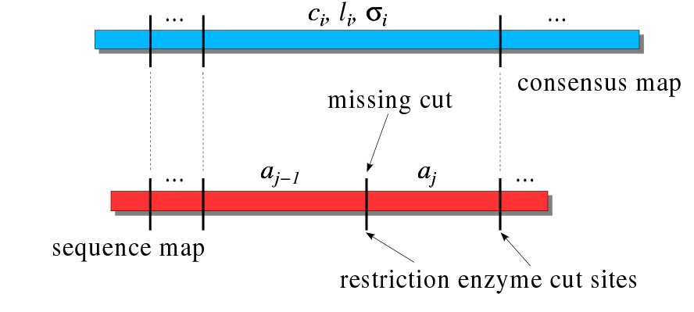
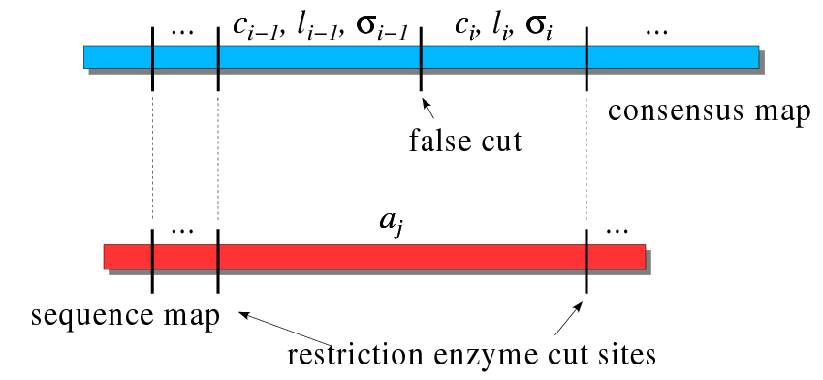
Cuts illustration
(Antoniotti et al.,
Technical report, 00)

Slide 27
SOLUTION

Slide 28
Case 1: no missing cuts and no false cuts
The probability of the i-th segment is:
After negative logarithm:

Slide 29
Case 2: Missing cuts and no false cuts
The term for a missing cut is:
After negative logarithm:

Slide 30
Case 3: no missing cut and some false cuts
Aggregate fragments i and i-1 of the consensus against the i-th fragment of the sequence map:
After negative logarithm:

Slide 31
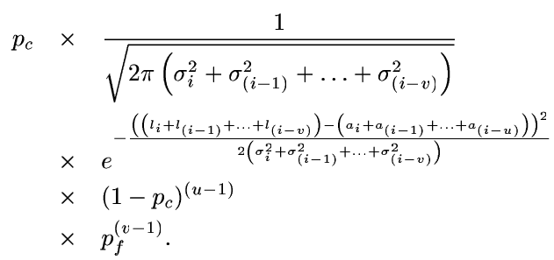
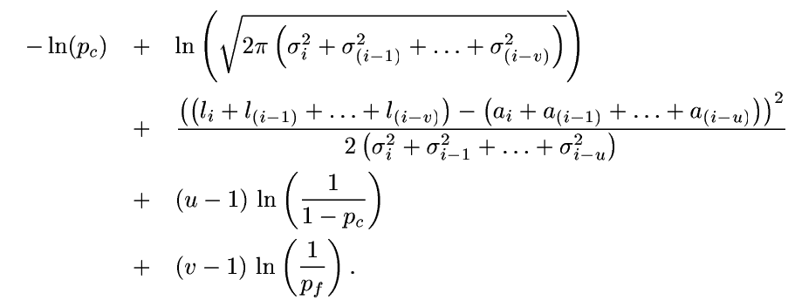
Case 4: putting it all together

Slide 32
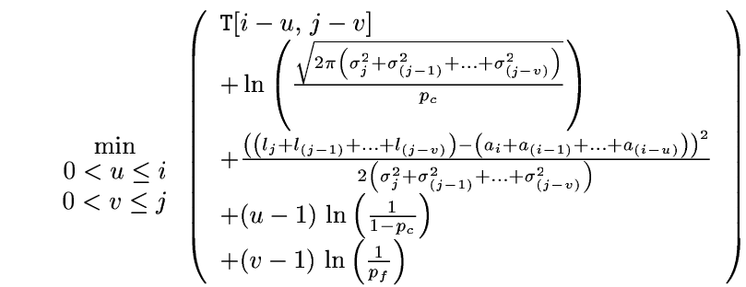
Dynamic programming
The optimal solution is found using DP.
T[i,j] = log probability of matching i fragments in the sequence map and j in the consensus =

Slide 33
Running time
T[n,m] requires O(n²m²) running time, where n and m = #fragments in the sequence and consensus maps, respectively.
Practically, u and v are bounded by 3, reducing the running time to O(nm).

Slide 34
Adding AT-content information
In each step of the DP, some fragments are matched.
The AT-content average is known experimentally and in silico.
We suggest adding a score for the difference in average AT-content.

Slide 35
Using several florescence tags
The input here is a vector of lengths, separated by colors.
A match is possible for the same color only.
Note that a swapping between adjacent colors is possible (each color filmed separately).

Slide 36
RESULTS

Slide 37
Simulation goals
Finding the minimal length of a DNA fragment that can be identified with high certainty.
Finding enzymes that minimize the number of fluorescence tags and the required length.
Measure parameters effect on accuracy to achieve better experimental design.

Slide 38
Simulation - Data Preprocessing
The human genome downloaded from UCSC.
From each chromosome, first and last 1Mbps (two chromosome arms) were extracted.
Arms with insufficient data (more than 50% N in the published sequence) were removed.

Slide 39
Simulation – Modeling
Given a reference sequence, an optical map is generated using the following parameters:
p_{c} = true cut probability = 0.79.
p_{f} = false cut probability = 5×10⁻⁶ per bp.
σ = sizing error = 1000 bp.
Optical resolution = 1800 bp.

Slide 40
Simulation
Reference maps built from reference sequences.
For each sequence 100 optical maps are generated; each map is aligned against all reference maps to find the best match.
Repeated for different length in the range 25 Kbp – 1 Mbp (25 Kbp interval).

Slide 41
Simulation - results
For each length, results presented in a matrix.
M_{ij} – # times that the optical map generated from the i^{th} arm was best aligned to the reference map corresponding to the j^{th} arm.
Red = 100, blue = 0.

Slide 42
1 Mbp, BspqI &BseCI
 | chr1p | chr1q | chr2p | chr2q | chr3p | chr3q | chr4p | chr4q | chr5p | chr5q | chr6p | chr6q | chr7p | chr7q | chr8p | chr8q | chr9p | chr9q | chr10p | chr10q | chr11p | chr11q | chr12p | chr12q | chr13q | chr14q | chr15q | chr16p | chr16q | chr17p | chr17q | chr18p | chr18q | chr19p | chr19q | chr20p | chr20q | chr21q | chr22q | chrXq
chr1p | 100 | 0 | 0 | 0 | 0 | 0 | 0 | 0 | 0 | 0 | 0 | 0 | 0 | 0 | 0 | 0 | 0 | 0 | 0 | 0 | 0 | 0 | 0 | 0 | 0 | 0 | 0 | 0 | 0 | 0 | 0 | 0 | 0 | 0 | 0 | 0 | 0 | 0 | 0 | 0
chr1q | 0 | 100 | 0 | 0 | 0 | 0 | 0 | 0 | 0 | 0 | 0 | 0 | 0 | 0 | 0 | 0 | 0 | 0 | 0 | 0 | 0 | 0 | 0 | 0 | 0 | 0 | 0 | 0 | 0 | 0 | 0 | 0 | 0 | 0 | 0 | 0 | 0 | 0 | 0 | 0
chr2p | 0 | 0 | 100 | 0 | 0 | 0 | 0 | 0 | 0 | 0 | 0 | 0 | 0 | 0 | 0 | 0 | 0 | 0 | 0 | 0 | 0 | 0 | 0 | 0 | 0 | 0 | 0 | 0 | 0 | 0 | 0 | 0 | 0 | 0 | 0 | 0 | 0 | 0 | 0 | 0
chr2q | 0 | 0 | 0 | 100 | 0 | 0 | 0 | 0 | 0 | 0 | 0 | 0 | 0 | 0 | 0 | 0 | 0 | 0 | 0 | 0 | 0 | 0 | 0 | 0 | 0 | 0 | 0 | 0 | 0 | 0 | 0 | 0 | 0 | 0 | 0 | 0 | 0 | 0 | 0 | 0
chr3p | 0 | 0 | 0 | 0 | 100 | 0 | 0 | 0 | 0 | 0 | 0 | 0 | 0 | 0 | 0 | 0 | 0 | 0 | 0 | 0 | 0 | 0 | 0 | 0 | 0 | 0 | 0 | 0 | 0 | 0 | 0 | 0 | 0 | 0 | 0 | 0 | 0 | 0 | 0 | 0
chr3q | 0 | 0 | 0 | 0 | 0 | 100 | 0 | 0 | 0 | 0 | 0 | 0 | 0 | 0 | 0 | 0 | 0 | 0 | 0 | 0 | 0 | 0 | 0 | 0 | 0 | 0 | 0 | 0 | 0 | 0 | 0 | 0 | 0 | 0 | 0 | 0 | 0 | 0 | 0 | 0
chr4p | 0 | 0 | 0 | 0 | 0 | 0 | 100 | 0 | 0 | 0 | 0 | 0 | 0 | 0 | 0 | 0 | 0 | 0 | 0 | 0 | 0 | 0 | 0 | 0 | 0 | 0 | 0 | 0 | 0 | 0 | 0 | 0 | 0 | 0 | 0 | 0 | 0 | 0 | 0 | 0
chr4q | 0 | 0 | 0 | 0 | 0 | 1 | 0 | 99 | 0 | 0 | 0 | 0 | 0 | 0 | 0 | 0 | 0 | 0 | 0 | 0 | 0 | 0 | 0 | 0 | 0 | 0 | 0 | 0 | 0 | 0 | 0 | 0 | 0 | 0 | 0 | 0 | 0 | 0 | 0 | 0
chr5p | 0 | 0 | 0 | 0 | 0 | 0 | 0 | 0 | 100 | 0 | 0 | 0 | 0 | 0 | 0 | 0 | 0 | 0 | 0 | 0 | 0 | 0 | 0 | 0 | 0 | 0 | 0 | 0 | 0 | 0 | 0 | 0 | 0 | 0 | 0 | 0 | 0 | 0 | 0 | 0
chr5q | 0 | 0 | 0 | 0 | 0 | 0 | 0 | 0 | 0 | 100 | 0 | 0 | 0 | 0 | 0 | 0 | 0 | 0 | 0 | 0 | 0 | 0 | 0 | 0 | 0 | 0 | 0 | 0 | 0 | 0 | 0 | 0 | 0 | 0 | 0 | 0 | 0 | 0 | 0 | 0
chr6p | 0 | 0 | 0 | 0 | 0 | 0 | 0 | 0 | 0 | 0 | 100 | 0 | 0 | 0 | 0 | 0 | 0 | 0 | 0 | 0 | 0 | 0 | 0 | 0 | 0 | 0 | 0 | 0 | 0 | 0 | 0 | 0 | 0 | 0 | 0 | 0 | 0 | 0 | 0 | 0
chr6q | 0 | 0 | 0 | 0 | 0 | 0 | 0 | 0 | 0 | 0 | 0 | 100 | 0 | 0 | 0 | 0 | 0 | 0 | 0 | 0 | 0 | 0 | 0 | 0 | 0 | 0 | 0 | 0 | 0 | 0 | 0 | 0 | 0 | 0 | 0 | 0 | 0 | 0 | 0 | 0
chr7p | 0 | 0 | 0 | 0 | 0 | 0 | 0 | 0 | 0 | 0 | 0 | 0 | 100 | 0 | 0 | 0 | 0 | 0 | 0 | 0 | 0 | 0 | 0 | 0 | 0 | 0 | 0 | 0 | 0 | 0 | 0 | 0 | 0 | 0 | 0 | 0 | 0 | 0 | 0 | 0
chr7q | 0 | 0 | 0 | 0 | 0 | 0 | 0 | 0 | 0 | 0 | 0 | 0 | 0 | 100 | 0 | 0 | 0 | 0 | 0 | 0 | 0 | 0 | 0 | 0 | 0 | 0 | 0 | 0 | 0 | 0 | 0 | 0 | 0 | 0 | 0 | 0 | 0 | 0 | 0 | 0
chr8p | 0 | 0 | 0 | 0 | 0 | 0 | 0 | 0 | 0 | 0 | 0 | 0 | 0 | 0 | 100 | 0 | 0 | 0 | 0 | 0 | 0 | 0 | 0 | 0 | 0 | 0 | 0 | 0 | 0 | 0 | 0 | 0 | 0 | 0 | 0 | 0 | 0 | 0 | 0 | 0
chr8q | 0 | 0 | 0 | 7 | 0 | 0 | 0 | 0 | 0 | 0 | 0 | 0 | 0 | 0 | 2 | 85 | 0 | 0 | 0 | 0 | 0 | 4 | 0 | 0 | 0 | 0 | 0 | 0 | 0 | 0 | 0 | 0 | 0 | 0 | 0 | 0 | 0 | 2 | 0 | 0
chr9p | 0 | 0 | 0 | 0 | 0 | 0 | 0 | 0 | 0 | 0 | 0 | 0 | 0 | 0 | 0 | 0 | 100 | 0 | 0 | 0 | 0 | 0 | 0 | 0 | 0 | 0 | 0 | 0 | 0 | 0 | 0 | 0 | 0 | 0 | 0 | 0 | 0 | 0 | 0 | 0
chr9q | 0 | 0 | 0 | 0 | 0 | 0 | 0 | 0 | 0 | 0 | 0 | 0 | 0 | 0 | 1 | 0 | 0 | 99 | 0 | 0 | 0 | 0 | 0 | 0 | 0 | 0 | 0 | 0 | 0 | 0 | 0 | 0 | 0 | 0 | 0 | 0 | 0 | 0 | 0 | 0
chr10p | 0 | 0 | 0 | 0 | 0 | 0 | 0 | 0 | 0 | 0 | 0 | 0 | 0 | 0 | 0 | 0 | 0 | 0 | 100 | 0 | 0 | 0 | 0 | 0 | 0 | 0 | 0 | 0 | 0 | 0 | 0 | 0 | 0 | 0 | 0 | 0 | 0 | 0 | 0 | 0
chr10q | 0 | 0 | 0 | 0 | 0 | 0 | 0 | 0 | 0 | 0 | 0 | 0 | 0 | 0 | 0 | 0 | 0 | 0 | 0 | 100 | 0 | 0 | 0 | 0 | 0 | 0 | 0 | 0 | 0 | 0 | 0 | 0 | 0 | 0 | 0 | 0 | 0 | 0 | 0 | 0
chr11p | 0 | 0 | 0 | 0 | 0 | 0 | 0 | 0 | 0 | 0 | 0 | 0 | 1 | 0 | 0 | 0 | 0 | 0 | 0 | 0 | 99 | 0 | 0 | 0 | 0 | 0 | 0 | 0 | 0 | 0 | 0 | 0 | 0 | 0 | 0 | 0 | 0 | 0 | 0 | 0
chr11q | 0 | 0 | 0 | 0 | 0 | 0 | 0 | 0 | 0 | 0 | 0 | 0 | 0 | 0 | 0 | 0 | 0 | 0 | 0 | 0 | 0 | 100 | 0 | 0 | 0 | 0 | 0 | 0 | 0 | 0 | 0 | 0 | 0 | 0 | 0 | 0 | 0 | 0 | 0 | 0
chr12p | 0 | 0 | 0 | 0 | 0 | 0 | 0 | 0 | 0 | 0 | 0 | 0 | 0 | 0 | 0 | 0 | 0 | 0 | 0 | 0 | 0 | 0 | 100 | 0 | 0 | 0 | 0 | 0 | 0 | 0 | 0 | 0 | 0 | 0 | 0 | 0 | 0 | 0 | 0 | 0
chr12q | 0 | 0 | 0 | 0 | 0 | 0 | 0 | 0 | 0 | 0 | 0 | 0 | 0 | 0 | 0 | 0 | 0 | 0 | 0 | 0 | 0 | 0 | 0 | 100 | 0 | 0 | 0 | 0 | 0 | 0 | 0 | 0 | 0 | 0 | 0 | 0 | 0 | 0 | 0 | 0
chr13q | 0 | 0 | 0 | 0 | 0 | 0 | 0 | 0 | 0 | 0 | 0 | 0 | 0 | 0 | 0 | 0 | 0 | 0 | 0 | 0 | 0 | 0 | 0 | 0 | 100 | 0 | 0 | 0 | 0 | 0 | 0 | 0 | 0 | 0 | 0 | 0 | 0 | 0 | 0 | 0
chr14q | 0 | 0 | 0 | 0 | 0 | 0 | 0 | 0 | 0 | 0 | 0 | 0 | 0 | 0 | 0 | 0 | 0 | 0 | 0 | 0 | 0 | 0 | 0 | 0 | 0 | 100 | 0 | 0 | 0 | 0 | 0 | 0 | 0 | 0 | 0 | 0 | 0 | 0 | 0 | 0
chr15q | 0 | 0 | 0 | 0 | 0 | 0 | 0 | 0 | 0 | 0 | 0 | 0 | 0 | 0 | 0 | 0 | 0 | 0 | 0 | 0 | 0 | 0 | 0 | 0 | 0 | 0 | 100 | 0 | 0 | 0 | 0 | 0 | 0 | 0 | 0 | 0 | 0 | 0 | 0 | 0
chr16p | 0 | 0 | 0 | 0 | 0 | 0 | 0 | 0 | 0 | 0 | 0 | 0 | 0 | 0 | 0 | 0 | 0 | 0 | 0 | 0 | 0 | 0 | 0 | 0 | 0 | 0 | 0 | 100 | 0 | 0 | 0 | 0 | 0 | 0 | 0 | 0 | 0 | 0 | 0 | 0
chr16q | 0 | 0 | 0 | 0 | 0 | 0 | 0 | 0 | 0 | 0 | 0 | 0 | 0 | 0 | 0 | 0 | 0 | 0 | 0 | 0 | 0 | 0 | 0 | 0 | 0 | 0 | 0 | 0 | 100 | 0 | 0 | 0 | 0 | 0 | 0 | 0 | 0 | 0 | 0 | 0
chr17p | 0 | 0 | 0 | 0 | 0 | 0 | 0 | 0 | 0 | 0 | 0 | 0 | 0 | 0 | 0 | 0 | 0 | 0 | 0 | 0 | 0 | 0 | 0 | 0 | 0 | 0 | 0 | 0 | 0 | 100 | 0 | 0 | 0 | 0 | 0 | 0 | 0 | 0 | 0 | 0
chr17q | 0 | 0 | 0 | 0 | 0 | 0 | 0 | 0 | 0 | 0 | 0 | 0 | 0 | 0 | 0 | 0 | 0 | 0 | 0 | 0 | 0 | 0 | 0 | 0 | 0 | 0 | 0 | 0 | 0 | 0 | 100 | 0 | 0 | 0 | 0 | 0 | 0 | 0 | 0 | 0
chr18p | 0 | 0 | 0 | 0 | 0 | 0 | 0 | 0 | 0 | 0 | 0 | 0 | 0 | 0 | 0 | 0 | 0 | 0 | 0 | 0 | 0 | 0 | 0 | 0 | 0 | 0 | 0 | 0 | 0 | 0 | 0 | 100 | 0 | 0 | 0 | 0 | 0 | 0 | 0 | 0
chr18q | 0 | 0 | 0 | 0 | 0 | 0 | 0 | 0 | 0 | 0 | 0 | 0 | 0 | 0 | 0 | 0 | 0 | 0 | 0 | 0 | 0 | 0 | 0 | 0 | 0 | 0 | 0 | 0 | 0 | 0 | 0 | 0 | 100 | 0 | 0 | 0 | 0 | 0 | 0 | 0
chr19p | 0 | 0 | 0 | 0 | 0 | 0 | 0 | 0 | 0 | 0 | 0 | 0 | 0 | 0 | 0 | 0 | 0 | 0 | 0 | 0 | 0 | 0 | 0 | 0 | 0 | 0 | 0 | 0 | 0 | 0 | 0 | 0 | 0 | 100 | 0 | 0 | 0 | 0 | 0 | 0
chr19q | 0 | 0 | 0 | 0 | 0 | 0 | 0 | 0 | 0 | 0 | 0 | 0 | 0 | 0 | 0 | 0 | 0 | 0 | 0 | 0 | 0 | 0 | 0 | 0 | 0 | 0 | 0 | 0 | 0 | 0 | 0 | 0 | 0 | 0 | 100 | 0 | 0 | 0 | 0 | 0
chr20p | 0 | 0 | 0 | 0 | 0 | 0 | 0 | 0 | 0 | 0 | 0 | 0 | 0 | 0 | 0 | 0 | 0 | 0 | 0 | 0 | 0 | 0 | 0 | 0 | 0 | 0 | 0 | 0 | 0 | 0 | 0 | 0 | 0 | 0 | 0 | 100 | 0 | 0 | 0 | 0
chr20q | 0 | 0 | 0 | 0 | 0 | 0 | 0 | 0 | 0 | 0 | 0 | 0 | 0 | 0 | 0 | 0 | 0 | 0 | 0 | 0 | 0 | 0 | 0 | 0 | 0 | 0 | 0 | 0 | 0 | 0 | 0 | 0 | 0 | 0 | 0 | 0 | 100 | 0 | 0 | 0
chr21q | 0 | 0 | 0 | 0 | 0 | 0 | 0 | 0 | 0 | 0 | 0 | 0 | 0 | 0 | 0 | 0 | 0 | 0 | 0 | 0 | 0 | 0 | 0 | 0 | 0 | 0 | 0 | 0 | 0 | 0 | 0 | 0 | 0 | 0 | 0 | 0 | 0 | 100 | 0 | 0
chr22q | 0 | 0 | 0 | 0 | 0 | 0 | 0 | 0 | 0 | 0 | 0 | 0 | 0 | 0 | 0 | 0 | 0 | 0 | 0 | 0 | 0 | 0 | 0 | 0 | 0 | 0 | 0 | 0 | 0 | 0 | 0 | 0 | 0 | 0 | 0 | 0 | 0 | 0 | 100 | 0
chrXq | 0 | 0 | 0 | 0 | 0 | 0 | 0 | 0 | 0 | 0 | 0 | 0 | 0 | 0 | 0 | 0 | 0 | 0 | 0 | 0 | 0 | 0 | 0 | 0 | 0 | 0 | 0 | 0 | 0 | 0 | 0 | 0 | 0 | 0 | 0 | 0 | 0 | 0 | 0 | 100

Slide 43
700 Kbp, BspqI &BseCI
 | chr1p | chr1q | chr2p | chr2q | chr3p | chr3q | chr4p | chr4q | chr5p | chr5q | chr6p | chr6q | chr7p | chr7q | chr8p | chr8q | chr9p | chr9q | chr10p | chr10q | chr11p | chr11q | chr12p | chr12q | chr13q | chr14q | chr15q | chr16p | chr16q | chr17p | chr17q | chr18p | chr18q | chr19p | chr19q | chr20p | chr20q | chr21q | chr22q | chrXq
chr1p | 100 | 0 | 0 | 0 | 0 | 0 | 0 | 0 | 0 | 0 | 0 | 0 | 0 | 0 | 0 | 0 | 0 | 0 | 0 | 0 | 0 | 0 | 0 | 0 | 0 | 0 | 0 | 0 | 0 | 0 | 0 | 0 | 0 | 0 | 0 | 0 | 0 | 0 | 0 | 0
chr1q | 0 | 100 | 0 | 0 | 0 | 0 | 0 | 0 | 0 | 0 | 0 | 0 | 0 | 0 | 0 | 0 | 0 | 0 | 0 | 0 | 0 | 0 | 0 | 0 | 0 | 0 | 0 | 0 | 0 | 0 | 0 | 0 | 0 | 0 | 0 | 0 | 0 | 0 | 0 | 0
chr2p | 0 | 0 | 97 | 1 | 0 | 0 | 0 | 0 | 0 | 0 | 1 | 0 | 0 | 0 | 0 | 0 | 0 | 0 | 0 | 0 | 0 | 1 | 0 | 0 | 0 | 0 | 0 | 0 | 0 | 0 | 0 | 0 | 0 | 0 | 0 | 0 | 0 | 0 | 0 | 0
chr2q | 0 | 0 | 0 | 99 | 0 | 0 | 0 | 0 | 0 | 0 | 0 | 0 | 0 | 0 | 0 | 0 | 0 | 0 | 0 | 0 | 0 | 0 | 0 | 0 | 0 | 0 | 0 | 1 | 0 | 0 | 0 | 0 | 0 | 0 | 0 | 0 | 0 | 0 | 0 | 0
chr3p | 0 | 0 | 1 | 1 | 92 | 0 | 0 | 0 | 1 | 0 | 0 | 0 | 0 | 0 | 0 | 0 | 1 | 0 | 0 | 0 | 0 | 0 | 0 | 0 | 0 | 0 | 0 | 0 | 1 | 0 | 1 | 0 | 1 | 0 | 0 | 0 | 0 | 1 | 0 | 0
chr3q | 0 | 0 | 0 | 1 | 0 | 91 | 0 | 0 | 0 | 0 | 0 | 0 | 0 | 0 | 2 | 0 | 1 | 0 | 0 | 0 | 0 | 0 | 0 | 0 | 0 | 0 | 2 | 0 | 0 | 0 | 0 | 0 | 0 | 1 | 0 | 0 | 2 | 0 | 0 | 0
chr4p | 0 | 0 | 0 | 0 | 0 | 0 | 99 | 0 | 0 | 0 | 0 | 0 | 0 | 0 | 0 | 0 | 0 | 0 | 0 | 0 | 0 | 0 | 0 | 0 | 0 | 0 | 0 | 0 | 0 | 0 | 0 | 0 | 0 | 0 | 0 | 0 | 0 | 1 | 0 | 0
chr4q | 0 | 0 | 1 | 1 | 0 | 1 | 0 | 81 | 1 | 0 | 0 | 0 | 0 | 0 | 1 | 1 | 0 | 1 | 0 | 3 | 0 | 0 | 0 | 1 | 0 | 0 | 0 | 1 | 1 | 0 | 1 | 0 | 0 | 0 | 0 | 0 | 3 | 1 | 0 | 1
chr5p | 0 | 0 | 0 | 1 | 0 | 0 | 0 | 0 | 95 | 0 | 0 | 0 | 0 | 0 | 0 | 0 | 0 | 1 | 0 | 0 | 0 | 1 | 0 | 0 | 0 | 0 | 0 | 0 | 0 | 0 | 1 | 0 | 1 | 0 | 0 | 0 | 0 | 0 | 0 | 0
chr5q | 0 | 0 | 0 | 1 | 0 | 0 | 2 | 0 | 0 | 94 | 0 | 0 | 0 | 0 | 0 | 0 | 0 | 0 | 0 | 0 | 0 | 3 | 0 | 0 | 0 | 0 | 0 | 0 | 0 | 0 | 0 | 0 | 0 | 0 | 0 | 0 | 0 | 0 | 0 | 0
chr6p | 0 | 1 | 0 | 0 | 0 | 0 | 0 | 0 | 1 | 0 | 89 | 1 | 0 | 0 | 0 | 0 | 0 | 0 | 0 | 0 | 0 | 5 | 0 | 2 | 0 | 0 | 0 | 0 | 0 | 0 | 1 | 0 | 0 | 0 | 0 | 0 | 0 | 0 | 0 | 0
chr6q | 0 | 0 | 0 | 0 | 0 | 0 | 0 | 0 | 0 | 0 | 0 | 99 | 0 | 0 | 0 | 0 | 0 | 0 | 0 | 0 | 0 | 0 | 0 | 1 | 0 | 0 | 0 | 0 | 0 | 0 | 0 | 0 | 0 | 0 | 0 | 0 | 0 | 0 | 0 | 0
chr7p | 0 | 0 | 0 | 0 | 0 | 0 | 0 | 0 | 0 | 0 | 0 | 0 | 96 | 1 | 0 | 0 | 0 | 0 | 0 | 0 | 0 | 0 | 0 | 0 | 0 | 0 | 0 | 0 | 1 | 0 | 0 | 0 | 0 | 0 | 0 | 1 | 0 | 1 | 0 | 0
chr7q | 0 | 0 | 0 | 0 | 0 | 1 | 0 | 0 | 0 | 0 | 0 | 0 | 0 | 96 | 0 | 0 | 0 | 0 | 0 | 0 | 0 | 1 | 0 | 0 | 0 | 0 | 0 | 0 | 0 | 0 | 1 | 0 | 0 | 0 | 0 | 0 | 1 | 0 | 0 | 0
chr8p | 0 | 0 | 0 | 2 | 0 | 0 | 1 | 0 | 5 | 0 | 0 | 0 | 1 | 0 | 84 | 0 | 1 | 1 | 0 | 1 | 0 | 1 | 0 | 0 | 0 | 0 | 0 | 0 | 0 | 0 | 0 | 0 | 3 | 0 | 0 | 0 | 0 | 0 | 0 | 0
chr8q | 0 | 1 | 1 | 1 | 0 | 0 | 0 | 0 | 1 | 0 | 0 | 0 | 5 | 0 | 1 | 84 | 0 | 1 | 0 | 0 | 0 | 2 | 0 | 0 | 0 | 0 | 0 | 0 | 0 | 0 | 0 | 0 | 1 | 0 | 1 | 0 | 0 | 0 | 1 | 0
chr9p | 0 | 0 | 0 | 0 | 0 | 1 | 0 | 0 | 0 | 0 | 1 | 0 | 0 | 0 | 0 | 0 | 94 | 0 | 0 | 0 | 0 | 0 | 0 | 1 | 0 | 0 | 0 | 1 | 2 | 0 | 0 | 0 | 0 | 0 | 0 | 0 | 0 | 0 | 0 | 0
chr9q | 0 | 0 | 0 | 3 | 1 | 0 | 0 | 0 | 6 | 1 | 2 | 0 | 1 | 1 | 4 | 0 | 0 | 68 | 0 | 0 | 0 | 8 | 1 | 1 | 0 | 0 | 0 | 0 | 1 | 0 | 0 | 0 | 0 | 0 | 0 | 0 | 0 | 2 | 0 | 0
chr10p | 0 | 0 | 0 | 0 | 0 | 0 | 0 | 0 | 1 | 2 | 0 | 0 | 0 | 0 | 1 | 0 | 0 | 1 | 91 | 1 | 0 | 1 | 0 | 1 | 0 | 0 | 0 | 0 | 0 | 0 | 0 | 0 | 0 | 0 | 0 | 0 | 1 | 0 | 0 | 0
chr10q | 0 | 0 | 0 | 1 | 0 | 1 | 0 | 1 | 0 | 0 | 0 | 0 | 0 | 1 | 1 | 1 | 1 | 0 | 0 | 92 | 0 | 0 | 0 | 0 | 0 | 0 | 0 | 0 | 1 | 0 | 0 | 0 | 0 | 0 | 0 | 0 | 0 | 0 | 0 | 0
chr11p | 0 | 0 | 1 | 2 | 0 | 0 | 0 | 0 | 0 | 0 | 0 | 0 | 2 | 0 | 2 | 0 | 0 | 0 | 0 | 1 | 86 | 2 | 0 | 0 | 0 | 1 | 0 | 0 | 0 | 0 | 1 | 0 | 0 | 0 | 0 | 0 | 1 | 0 | 1 | 0
chr11q | 0 | 0 | 0 | 0 | 0 | 0 | 0 | 0 | 0 | 0 | 0 | 0 | 0 | 0 | 0 | 0 | 0 | 0 | 0 | 0 | 0 | 98 | 0 | 1 | 0 | 0 | 0 | 0 | 0 | 0 | 0 | 0 | 1 | 0 | 0 | 0 | 0 | 0 | 0 | 0
chr12p | 0 | 0 | 0 | 0 | 0 | 0 | 0 | 0 | 0 | 0 | 0 | 0 | 0 | 0 | 0 | 0 | 0 | 0 | 0 | 0 | 0 | 1 | 98 | 0 | 0 | 0 | 0 | 0 | 0 | 0 | 0 | 0 | 0 | 0 | 0 | 0 | 0 | 1 | 0 | 0
chr12q | 0 | 0 | 0 | 0 | 0 | 0 | 0 | 0 | 1 | 2 | 0 | 0 | 0 | 0 | 0 | 0 | 0 | 0 | 0 | 0 | 0 | 1 | 0 | 96 | 0 | 0 | 0 | 0 | 0 | 0 | 0 | 0 | 0 | 0 | 0 | 0 | 0 | 0 | 0 | 0
chr13q | 0 | 0 | 0 | 0 | 0 | 0 | 0 | 0 | 0 | 0 | 0 | 0 | 0 | 0 | 0 | 0 | 0 | 0 | 0 | 0 | 0 | 0 | 0 | 0 | 99 | 0 | 0 | 0 | 0 | 1 | 0 | 0 | 0 | 0 | 0 | 0 | 0 | 0 | 0 | 0
chr14q | 0 | 0 | 0 | 0 | 0 | 0 | 0 | 0 | 0 | 0 | 0 | 0 | 0 | 0 | 1 | 0 | 0 | 1 | 0 | 0 | 0 | 0 | 0 | 0 | 0 | 97 | 0 | 0 | 0 | 0 | 0 | 0 | 0 | 0 | 0 | 0 | 1 | 0 | 0 | 0
chr15q | 0 | 0 | 0 | 0 | 0 | 2 | 0 | 0 | 1 | 0 | 1 | 0 | 0 | 0 | 0 | 0 | 0 | 0 | 0 | 0 | 0 | 2 | 0 | 1 | 0 | 0 | 92 | 0 | 0 | 0 | 0 | 0 | 1 | 0 | 0 | 0 | 0 | 0 | 0 | 0
chr16p | 0 | 0 | 0 | 0 | 0 | 0 | 0 | 0 | 0 | 0 | 0 | 0 | 1 | 0 | 0 | 0 | 0 | 0 | 0 | 0 | 0 | 1 | 0 | 0 | 0 | 0 | 0 | 97 | 0 | 0 | 1 | 0 | 0 | 0 | 0 | 0 | 0 | 0 | 0 | 0
chr16q | 0 | 0 | 0 | 0 | 0 | 0 | 1 | 0 | 0 | 0 | 1 | 2 | 0 | 0 | 1 | 0 | 0 | 0 | 0 | 0 | 0 | 0 | 0 | 0 | 0 | 0 | 0 | 0 | 95 | 0 | 0 | 0 | 0 | 0 | 0 | 0 | 0 | 0 | 0 | 0
chr17p | 0 | 0 | 0 | 0 | 0 | 0 | 0 | 0 | 0 | 0 | 0 | 0 | 0 | 0 | 0 | 0 | 0 | 0 | 0 | 0 | 0 | 0 | 0 | 0 | 0 | 0 | 0 | 0 | 0 | 100 | 0 | 0 | 0 | 0 | 0 | 0 | 0 | 0 | 0 | 0
chr17q | 0 | 0 | 0 | 2 | 0 | 0 | 0 | 0 | 0 | 0 | 1 | 2 | 0 | 0 | 1 | 0 | 0 | 0 | 0 | 0 | 0 | 4 | 0 | 0 | 0 | 0 | 0 | 0 | 0 | 0 | 90 | 0 | 0 | 0 | 0 | 0 | 0 | 0 | 0 | 0
chr18p | 0 | 0 | 0 | 0 | 0 | 0 | 0 | 0 | 0 | 0 | 1 | 0 | 0 | 0 | 0 | 0 | 0 | 0 | 0 | 0 | 0 | 0 | 0 | 0 | 0 | 0 | 0 | 0 | 0 | 0 | 0 | 99 | 0 | 0 | 0 | 0 | 0 | 0 | 0 | 0
chr18q | 0 | 0 | 0 | 2 | 0 | 0 | 0 | 0 | 1 | 0 | 1 | 0 | 1 | 0 | 4 | 0 | 1 | 0 | 0 | 0 | 0 | 4 | 1 | 0 | 0 | 0 | 0 | 0 | 0 | 0 | 0 | 0 | 82 | 0 | 0 | 2 | 1 | 0 | 0 | 0
chr19p | 0 | 0 | 0 | 0 | 0 | 0 | 0 | 0 | 0 | 0 | 1 | 0 | 0 | 0 | 1 | 0 | 0 | 0 | 0 | 0 | 0 | 1 | 0 | 0 | 0 | 0 | 0 | 0 | 0 | 0 | 0 | 0 | 0 | 94 | 0 | 1 | 2 | 0 | 0 | 0
chr19q | 0 | 0 | 0 | 1 | 0 | 0 | 0 | 0 | 0 | 0 | 0 | 0 | 0 | 0 | 0 | 0 | 0 | 0 | 0 | 0 | 0 | 0 | 0 | 0 | 0 | 0 | 0 | 0 | 0 | 0 | 0 | 0 | 0 | 0 | 99 | 0 | 0 | 0 | 0 | 0
chr20p | 0 | 0 | 0 | 0 | 0 | 0 | 0 | 0 | 0 | 0 | 0 | 0 | 1 | 0 | 0 | 0 | 1 | 0 | 0 | 0 | 0 | 0 | 0 | 0 | 0 | 0 | 0 | 0 | 1 | 0 | 0 | 0 | 0 | 0 | 0 | 96 | 1 | 0 | 0 | 0
chr20q | 0 | 0 | 0 | 1 | 0 | 1 | 0 | 0 | 1 | 0 | 0 | 0 | 0 | 0 | 5 | 0 | 0 | 1 | 0 | 0 | 0 | 0 | 1 | 0 | 0 | 0 | 0 | 0 | 0 | 0 | 0 | 0 | 0 | 0 | 0 | 0 | 90 | 0 | 0 | 0
chr21q | 0 | 0 | 1 | 0 | 0 | 0 | 0 | 0 | 2 | 0 | 0 | 0 | 0 | 0 | 1 | 1 | 0 | 0 | 0 | 0 | 0 | 2 | 0 | 0 | 0 | 0 | 0 | 0 | 0 | 0 | 0 | 0 | 0 | 0 | 0 | 0 | 0 | 93 | 0 | 0
chr22q | 0 | 0 | 0 | 0 | 0 | 2 | 1 | 0 | 0 | 0 | 0 | 0 | 1 | 0 | 2 | 1 | 0 | 2 | 0 | 1 | 0 | 2 | 0 | 0 | 0 | 0 | 1 | 1 | 1 | 0 | 0 | 0 | 0 | 0 | 0 | 1 | 2 | 0 | 82 | 0
chrXq | 0 | 0 | 1 | 1 | 0 | 0 | 0 | 1 | 0 | 0 | 0 | 0 | 0 | 0 | 0 | 0 | 0 | 0 | 0 | 0 | 0 | 0 | 0 | 0 | 0 | 0 | 0 | 0 | 0 | 0 | 1 | 0 | 0 | 0 | 0 | 0 | 0 | 0 | 0 | 96

Slide 44
400 Kbp, BspqI &BseCI
 | chr1p | chr1q | chr2p | chr2q | chr3p | chr3q | chr4p | chr4q | chr5p | chr5q | chr6p | chr6q | chr7p | chr7q | chr8p | chr8q | chr9p | chr9q | chr10p | chr10q | chr11p | chr11q | chr12p | chr12q | chr13q | chr14q | chr15q | chr16p | chr16q | chr17p | chr17q | chr18p | chr18q | chr19p | chr19q | chr20p | chr20q | chr21q | chr22q | chrXq
chr1p | 90 | 0 | 0 | 0 | 0 | 0 | 0 | 0 | 0 | 0 | 1 | 1 | 0 | 0 | 0 | 2 | 0 | 0 | 0 | 0 | 1 | 0 | 0 | 0 | 0 | 0 | 1 | 0 | 1 | 0 | 2 | 0 | 0 | 0 | 0 | 0 | 0 | 0 | 0 | 1
chr1q | 0 | 91 | 0 | 0 | 0 | 0 | 0 | 0 | 0 | 0 | 0 | 0 | 0 | 0 | 0 | 0 | 0 | 0 | 0 | 0 | 0 | 0 | 0 | 0 | 0 | 0 | 0 | 0 | 0 | 9 | 0 | 0 | 0 | 0 | 0 | 0 | 0 | 0 | 0 | 0
chr2p | 0 | 0 | 57 | 1 | 0 | 1 | 1 | 0 | 5 | 0 | 0 | 1 | 3 | 1 | 2 | 5 | 0 | 3 | 0 | 1 | 0 | 9 | 0 | 1 | 0 | 0 | 0 | 1 | 1 | 1 | 3 | 0 | 2 | 1 | 0 | 0 | 0 | 0 | 0 | 0
chr2q | 2 | 1 | 0 | 65 | 0 | 0 | 1 | 0 | 1 | 1 | 1 | 4 | 0 | 0 | 0 | 3 | 2 | 0 | 0 | 3 | 0 | 2 | 3 | 2 | 0 | 0 | 1 | 1 | 1 | 0 | 1 | 2 | 0 | 1 | 0 | 1 | 0 | 1 | 0 | 0
chr3p | 1 | 1 | 5 | 1 | 27 | 0 | 2 | 1 | 3 | 0 | 2 | 3 | 0 | 5 | 4 | 2 | 0 | 2 | 0 | 2 | 0 | 4 | 1 | 7 | 0 | 2 | 0 | 4 | 4 | 1 | 2 | 2 | 3 | 3 | 2 | 1 | 2 | 1 | 0 | 0
chr3q | 1 | 0 | 2 | 1 | 0 | 49 | 1 | 4 | 1 | 0 | 1 | 2 | 1 | 2 | 3 | 4 | 2 | 4 | 2 | 3 | 0 | 0 | 0 | 1 | 0 | 0 | 2 | 0 | 0 | 0 | 2 | 0 | 2 | 2 | 0 | 2 | 0 | 4 | 2 | 0
chr4p | 0 | 0 | 1 | 0 | 0 | 0 | 63 | 2 | 1 | 0 | 2 | 2 | 2 | 0 | 0 | 1 | 1 | 3 | 2 | 1 | 2 | 0 | 0 | 2 | 1 | 1 | 0 | 1 | 0 | 0 | 1 | 1 | 4 | 2 | 0 | 1 | 2 | 0 | 0 | 1
chr4q | 1 | 2 | 2 | 0 | 2 | 1 | 2 | 21 | 4 | 0 | 1 | 1 | 1 | 2 | 4 | 1 | 3 | 4 | 1 | 2 | 5 | 4 | 5 | 1 | 4 | 1 | 2 | 2 | 5 | 1 | 1 | 1 | 0 | 1 | 1 | 1 | 4 | 3 | 2 | 1
chr5p | 0 | 0 | 0 | 0 | 0 | 1 | 2 | 2 | 53 | 1 | 1 | 1 | 4 | 2 | 3 | 1 | 0 | 4 | 0 | 1 | 0 | 8 | 0 | 1 | 0 | 0 | 3 | 2 | 2 | 1 | 1 | 0 | 1 | 0 | 0 | 1 | 2 | 1 | 1 | 0
chr5q | 1 | 0 | 1 | 3 | 0 | 1 | 0 | 1 | 1 | 41 | 3 | 3 | 0 | 1 | 6 | 5 | 0 | 1 | 0 | 1 | 0 | 9 | 1 | 1 | 0 | 1 | 0 | 0 | 6 | 0 | 2 | 0 | 10 | 0 | 0 | 0 | 0 | 1 | 0 | 0
chr6p | 0 | 1 | 1 | 7 | 0 | 3 | 0 | 2 | 2 | 0 | 21 | 2 | 1 | 1 | 3 | 2 | 2 | 6 | 1 | 1 | 1 | 9 | 0 | 5 | 0 | 1 | 2 | 1 | 9 | 0 | 4 | 0 | 6 | 0 | 0 | 1 | 3 | 1 | 1 | 0
chr6q | 2 | 2 | 1 | 1 | 1 | 0 | 0 | 2 | 7 | 2 | 1 | 54 | 2 | 1 | 5 | 0 | 0 | 1 | 0 | 2 | 0 | 0 | 1 | 4 | 0 | 0 | 0 | 0 | 0 | 0 | 1 | 0 | 0 | 1 | 0 | 2 | 2 | 1 | 1 | 3
chr7p | 0 | 0 | 0 | 0 | 0 | 0 | 1 | 0 | 0 | 0 | 1 | 8 | 80 | 0 | 0 | 0 | 2 | 0 | 0 | 0 | 1 | 0 | 0 | 0 | 0 | 0 | 0 | 1 | 0 | 1 | 1 | 1 | 0 | 0 | 0 | 2 | 0 | 0 | 0 | 1
chr7q | 0 | 2 | 3 | 3 | 0 | 5 | 0 | 2 | 4 | 1 | 1 | 0 | 5 | 27 | 5 | 4 | 5 | 2 | 0 | 0 | 0 | 6 | 4 | 0 | 0 | 0 | 2 | 0 | 4 | 0 | 3 | 0 | 4 | 0 | 0 | 1 | 1 | 6 | 0 | 0
chr8p | 1 | 1 | 2 | 2 | 0 | 0 | 0 | 0 | 4 | 10 | 3 | 1 | 1 | 1 | 39 | 4 | 1 | 2 | 0 | 0 | 0 | 4 | 1 | 3 | 0 | 1 | 0 | 2 | 4 | 0 | 6 | 0 | 3 | 0 | 0 | 0 | 4 | 0 | 0 | 0
chr8q | 0 | 0 | 3 | 4 | 0 | 2 | 1 | 2 | 2 | 2 | 0 | 1 | 7 | 5 | 9 | 35 | 1 | 0 | 3 | 3 | 0 | 1 | 1 | 2 | 1 | 0 | 3 | 0 | 1 | 0 | 0 | 0 | 2 | 0 | 3 | 0 | 2 | 2 | 0 | 2
chr9p | 0 | 1 | 1 | 1 | 2 | 4 | 1 | 3 | 5 | 1 | 1 | 1 | 3 | 0 | 0 | 3 | 44 | 3 | 0 | 0 | 0 | 2 | 0 | 2 | 0 | 0 | 0 | 1 | 7 | 0 | 0 | 0 | 1 | 1 | 0 | 3 | 3 | 4 | 2 | 0
chr9q | 0 | 0 | 2 | 6 | 1 | 1 | 4 | 0 | 3 | 1 | 0 | 1 | 2 | 1 | 6 | 1 | 3 | 31 | 0 | 2 | 1 | 6 | 2 | 3 | 0 | 0 | 5 | 0 | 6 | 0 | 4 | 0 | 5 | 0 | 0 | 0 | 0 | 3 | 0 | 0
chr10p | 0 | 0 | 1 | 1 | 1 | 1 | 0 | 1 | 4 | 3 | 1 | 2 | 6 | 1 | 0 | 4 | 0 | 2 | 47 | 3 | 0 | 3 | 5 | 1 | 0 | 1 | 0 | 1 | 1 | 2 | 0 | 0 | 1 | 1 | 0 | 1 | 2 | 1 | 0 | 2
chr10q | 0 | 0 | 1 | 1 | 1 | 1 | 2 | 0 | 1 | 4 | 0 | 0 | 5 | 0 | 3 | 5 | 2 | 5 | 0 | 40 | 0 | 1 | 1 | 0 | 0 | 3 | 2 | 2 | 11 | 0 | 1 | 0 | 1 | 1 | 0 | 2 | 3 | 1 | 0 | 0
chr11p | 0 | 1 | 0 | 1 | 2 | 1 | 0 | 1 | 3 | 1 | 2 | 6 | 2 | 0 | 3 | 3 | 1 | 7 | 0 | 4 | 32 | 3 | 2 | 0 | 0 | 0 | 1 | 2 | 5 | 0 | 3 | 1 | 1 | 1 | 0 | 2 | 2 | 6 | 1 | 0
chr11q | 0 | 0 | 3 | 0 | 0 | 1 | 0 | 1 | 4 | 1 | 5 | 2 | 0 | 0 | 2 | 3 | 1 | 3 | 0 | 1 | 0 | 52 | 0 | 4 | 0 | 1 | 0 | 3 | 3 | 1 | 2 | 1 | 2 | 0 | 0 | 0 | 1 | 3 | 0 | 0
chr12p | 1 | 0 | 1 | 5 | 0 | 2 | 0 | 0 | 0 | 0 | 2 | 5 | 2 | 2 | 1 | 1 | 1 | 0 | 1 | 0 | 1 | 4 | 45 | 1 | 0 | 0 | 0 | 14 | 4 | 0 | 0 | 2 | 2 | 0 | 0 | 3 | 0 | 0 | 0 | 0
chr12q | 0 | 0 | 2 | 2 | 0 | 1 | 0 | 0 | 4 | 1 | 0 | 0 | 1 | 1 | 4 | 7 | 0 | 3 | 2 | 3 | 0 | 1 | 0 | 39 | 0 | 1 | 2 | 4 | 7 | 0 | 1 | 0 | 0 | 2 | 0 | 1 | 4 | 6 | 1 | 0
chr13q | 2 | 0 | 2 | 2 | 0 | 3 | 2 | 5 | 5 | 2 | 0 | 1 | 4 | 1 | 6 | 1 | 4 | 2 | 4 | 0 | 1 | 2 | 0 | 2 | 18 | 2 | 2 | 2 | 8 | 0 | 3 | 0 | 2 | 1 | 0 | 3 | 2 | 0 | 2 | 4
chr14q | 2 | 0 | 2 | 0 | 5 | 0 | 1 | 1 | 0 | 2 | 1 | 0 | 0 | 1 | 2 | 0 | 0 | 0 | 0 | 3 | 2 | 1 | 1 | 2 | 0 | 67 | 0 | 2 | 0 | 0 | 1 | 2 | 0 | 0 | 0 | 0 | 0 | 1 | 0 | 1
chr15q | 0 | 2 | 0 | 1 | 1 | 0 | 0 | 0 | 1 | 2 | 5 | 1 | 0 | 0 | 3 | 0 | 0 | 1 | 0 | 1 | 1 | 2 | 0 | 3 | 0 | 0 | 66 | 1 | 3 | 0 | 0 | 0 | 2 | 1 | 0 | 0 | 1 | 2 | 0 | 0
chr16p | 0 | 0 | 3 | 3 | 0 | 2 | 0 | 0 | 4 | 2 | 1 | 1 | 1 | 1 | 3 | 7 | 1 | 2 | 0 | 3 | 2 | 2 | 0 | 1 | 0 | 0 | 0 | 45 | 1 | 0 | 4 | 0 | 1 | 0 | 0 | 3 | 2 | 5 | 0 | 0
chr16q | 0 | 1 | 2 | 4 | 0 | 1 | 2 | 1 | 4 | 0 | 6 | 0 | 2 | 0 | 3 | 0 | 0 | 4 | 1 | 3 | 0 | 2 | 0 | 3 | 0 | 0 | 0 | 1 | 55 | 0 | 2 | 0 | 3 | 0 | 0 | 0 | 0 | 0 | 0 | 0
chr17p | 0 | 0 | 2 | 2 | 0 | 1 | 2 | 0 | 2 | 1 | 4 | 0 | 0 | 0 | 1 | 2 | 1 | 0 | 0 | 0 | 0 | 11 | 0 | 2 | 0 | 0 | 1 | 4 | 1 | 58 | 0 | 0 | 2 | 0 | 0 | 0 | 1 | 2 | 0 | 0
chr17q | 0 | 0 | 1 | 3 | 0 | 1 | 1 | 0 | 12 | 1 | 1 | 2 | 2 | 2 | 2 | 1 | 1 | 5 | 0 | 2 | 0 | 5 | 1 | 7 | 0 | 0 | 1 | 3 | 1 | 0 | 34 | 0 | 9 | 1 | 0 | 0 | 1 | 0 | 0 | 0
chr18p | 7 | 0 | 1 | 0 | 2 | 1 | 0 | 1 | 0 | 0 | 3 | 2 | 4 | 0 | 0 | 3 | 0 | 0 | 0 | 1 | 1 | 0 | 0 | 3 | 0 | 2 | 0 | 1 | 1 | 0 | 0 | 64 | 0 | 0 | 0 | 1 | 0 | 0 | 1 | 1
chr18q | 0 | 1 | 4 | 7 | 2 | 2 | 1 | 0 | 4 | 1 | 5 | 2 | 3 | 0 | 7 | 5 | 1 | 6 | 1 | 4 | 2 | 5 | 2 | 2 | 1 | 0 | 2 | 1 | 2 | 0 | 1 | 0 | 19 | 2 | 0 | 0 | 2 | 3 | 0 | 0
chr19p | 0 | 0 | 1 | 0 | 0 | 1 | 2 | 0 | 2 | 3 | 3 | 3 | 1 | 0 | 1 | 3 | 1 | 1 | 0 | 2 | 0 | 6 | 0 | 1 | 0 | 2 | 0 | 0 | 0 | 0 | 0 | 0 | 1 | 61 | 1 | 2 | 1 | 0 | 0 | 1
chr19q | 1 | 0 | 0 | 3 | 0 | 0 | 1 | 1 | 4 | 0 | 2 | 1 | 3 | 0 | 3 | 4 | 1 | 6 | 2 | 0 | 0 | 3 | 0 | 0 | 0 | 0 | 1 | 1 | 3 | 0 | 4 | 0 | 3 | 0 | 51 | 0 | 0 | 1 | 0 | 1
chr20p | 0 | 4 | 2 | 5 | 0 | 3 | 0 | 0 | 7 | 0 | 1 | 0 | 2 | 1 | 4 | 3 | 0 | 4 | 0 | 1 | 1 | 5 | 1 | 1 | 0 | 1 | 0 | 0 | 2 | 1 | 2 | 0 | 3 | 1 | 0 | 37 | 2 | 3 | 1 | 2
chr20q | 0 | 0 | 0 | 3 | 1 | 2 | 2 | 0 | 6 | 1 | 1 | 4 | 0 | 3 | 5 | 3 | 0 | 7 | 1 | 2 | 1 | 6 | 0 | 5 | 0 | 0 | 2 | 2 | 2 | 0 | 1 | 0 | 3 | 1 | 0 | 0 | 33 | 3 | 0 | 0
chr21q | 0 | 0 | 2 | 2 | 0 | 0 | 2 | 1 | 2 | 0 | 2 | 3 | 3 | 0 | 5 | 7 | 4 | 3 | 0 | 2 | 0 | 1 | 0 | 0 | 0 | 0 | 0 | 0 | 3 | 0 | 3 | 0 | 2 | 1 | 1 | 0 | 0 | 51 | 0 | 0
chr22q | 0 | 0 | 1 | 4 | 2 | 0 | 1 | 1 | 2 | 0 | 2 | 2 | 4 | 0 | 6 | 1 | 2 | 4 | 0 | 1 | 1 | 5 | 1 | 3 | 0 | 1 | 1 | 2 | 3 | 0 | 1 | 0 | 1 | 3 | 2 | 1 | 0 | 3 | 38 | 1
chrXq | 1 | 0 | 0 | 0 | 0 | 0 | 3 | 0 | 2 | 0 | 1 | 1 | 1 | 1 | 4 | 0 | 0 | 3 | 2 | 0 | 1 | 2 | 0 | 0 | 0 | 1 | 1 | 2 | 2 | 0 | 2 | 3 | 0 | 1 | 1 | 2 | 4 | 1 | 6 | 52

Slide 45
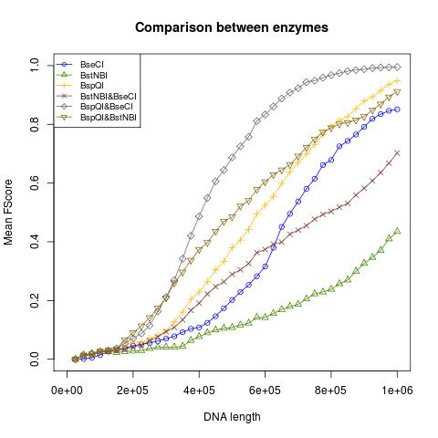
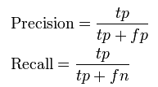
Comparing different enzymes

Slide 46
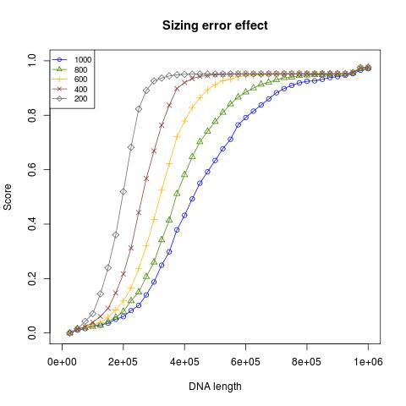
Accuracy vs. sizing error

Slide 47
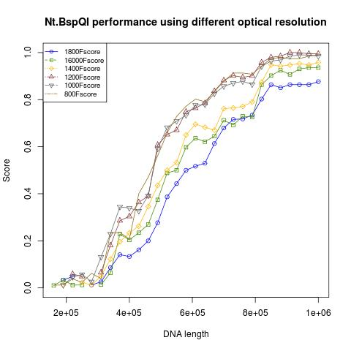
Accuracy vs. resolution

Slide 48
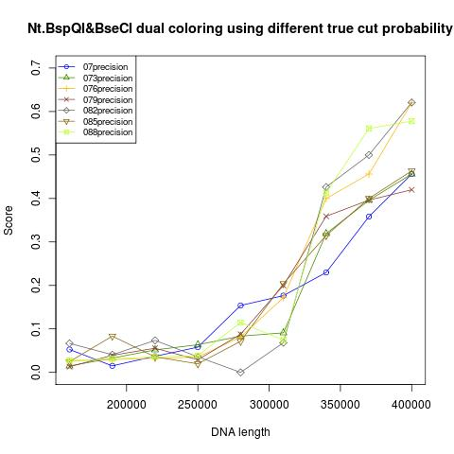
Accuracy vs. cut probability

Slide 49
SUMMARY

Slide 50
Summary 1
Optical mapping is a useful technology to measure variation in genomes.
Accurate mapping is necessary to measure single-cell variation and modifications.
Current sequencing technologies are still limited in these aspects.

Slide 51
Summary 2
Some enzymes are better than others.
Sizing error has a significant effect. It will be experimentally tested by Ebenstein’s lab.
Minimizing colors for mapping would leave more colors for measuring complex epigenetic modifications.

